Slide 1
Gesture-Controlled Smart Light System
Kushal Venkat mIkkilineni Siva Naga Malleswara Rao Vishnumolakala

Slide 2
System Overview
Objective: To build a smart lighting system controlled by hand gestures, enabling contactless operation.
Main Components:
Gesture Sensor (APDS-9960)
ESP32 Microcontroller
Relay Module
Wi-Fi for remote control (optional)
Use Case:
Touch-free lighting in smart homes or hygiene-sensitive areas.

Slide 3
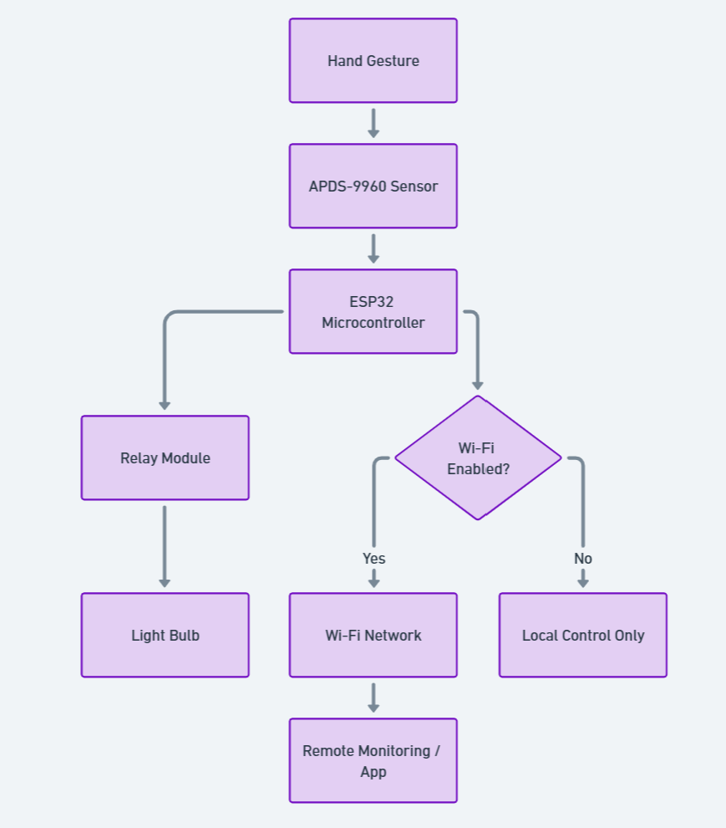
System Architecture
Data Flow:
Gesture ➝ APDS-9960 ➝ ESP32 ➝ Relay Module ➝ Light Bulb
Optional Path: ESP32 ➝ Wi-Fi ➝ Remote Monitoring/App

Slide 4
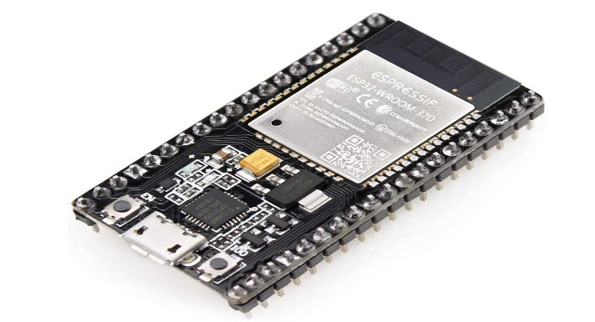
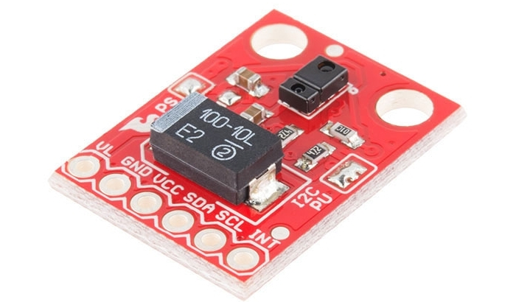
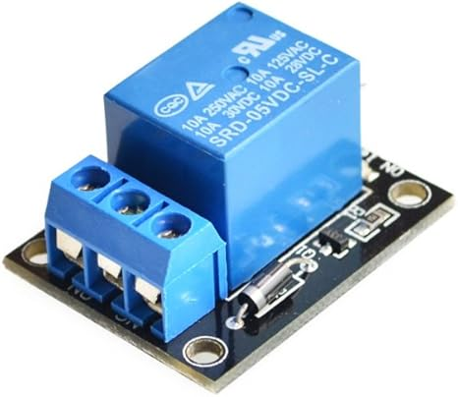
Hardware Selection & Justification
Microcontroller: ESP32
Chosen for built-in Wi-Fi/Bluetooth and GPIO support
Gesture Sensor: APDS-9960
Ideal for proximity and gesture detection
Relay Module:
Allows ESP32 to control high-voltage devices safely
Power Supply: USB power bank
Portable and sufficient for low-power design

Slide 5
Power Consumption & Efficiency
Estimated Consumption:
ESP32: ~0.53W
APDS-9960: ~0.01W
Relay Module: ~0.35W
Total: ~1W
Battery Life (5000mAh): ~5–6 hours
Efficiency Strategies:
ESP32 deep sleep mode
Sensor polling at intervals
Auto light-off timeout

Slide 6
Communication & Data Flow
Internal Communication:
Sensor ➝ ESP32: I2C Protocol
ESP32 ➝ Relay: Digital GPIO
Wireless Communication:
Wi-Fi: MQTT for remote control/dashboard
Bluetooth: Basic mobile setup or control
Data Flow Recap:
Gesture ➝ Sensor ➝ MCU ➝ Light Control
Optional ➝ MQTT ➝ Mobile/Web App

Slide 7
Integration Challenges & Solutions
Challenge | Solution
Gesture misreads | Calibration & filtering
Power usage | Low-power modes
Relay delay | Debounce logic
Wi-Fi dropout | Auto-reconnect / Bluetooth fallback
Voltage mismatch | Use level shifters or 3.3V-compatible relays

Slide 8
References
Thanh, L. L., Thanh Le, H., Nguyen, N. S. A., Quoc, A. L., & Quoc, K. H. (2024).
Babu, C. S., Purushothaman, R., Anusha, K., & Sakthi, S. (2023).

